Slide 1
ENGS 129
Bioimpedance
May 16, 2012

Slide 2
Bioimpedance basics
Bioimpedance refers to the electrical properties of biological tissue, when current flows through it.
Conductivity (σ) and permittivity (ε_{r}) are the two basic properties of bioimpedance.
I/V ratio define bioimpedance
Bioimpedance Spectroscopy
Conductivity
Frequency
Current Flow
Permittivity
Voltage Sense
Frequency
Current Source
Notes:
Two electrodes around a tissue …
what they found

Slide 3
Bioimpedance basics
Bioimpedance refers to the electrical properties of biological tissue, when current flows through it.
Conductivity (σ) and permittivity (ε_{r}) are the two basic properties of bioimpedance.
I/V ratio define bioimpedance
Biophysical tissue properties
influencing bioimpedance
Fluid ionic concentrations
Integrity of cell membranes
Morphological features
Cell types
Tissue type
Fluid flow
Temperature
Current Flow
Voltage Sense
Current Source

Slide 4
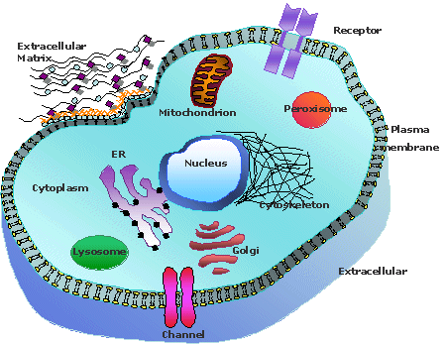
Current Out
Current In
Notes:
The factor I will talk most about is tissue morphology. So for example. If we look at a typical cell within some background of extracellular matrix and we try to pass a current through the tissue. The current will actually take multiple paths going through this tissue.

Slide 5
Low Frequency Current Path
High Frequency Current Path
Mid Frequency Current Path
Current Out
Current In
Notes:
It can split up and pass around the cell as shown by the red lines. It could pass directly through the cell as shown by the blue line. Or it could flow in combination through and around the cell. The path the current chooses depends on a number of things. One of the primary influences is the cell membrane.

Slide 6
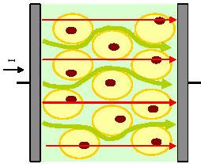
Bioimpedance basics
Bioimpedance Spectroscopy
High Frequency
Conductivity
Frequency
Low Frequency
Permittivity
Conductivity (σ)
Current flow → Fluids
Permittivity (ωε_{o}ε_{r})
Charge storage → Membranes
Frequency

Slide 7
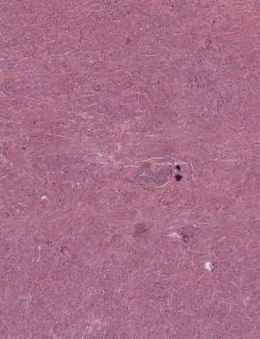
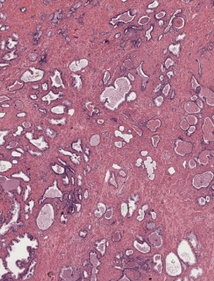
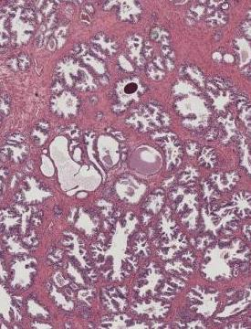
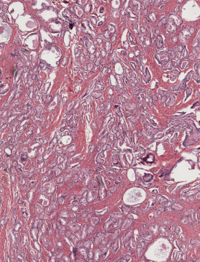
Rationale for EIS
Stroma
Normal Glandular Tissue
Benign Prostatic Hyperplasia
Prostatic Adenocarcinoma
500 μm
500 μm
500 μm
500 μm
Largely acellular
High levels of ECM
Primary functional units
Homogenous lumen size
Circular lumens
Increased # of glands
Increased luminal size
Papillary lumens
Dense structure of poorly formed small glands.
Low levels of ECM
Notes:
So why do we expect the electrical properties to differ in prostate. Here are H and E slides of the four primary tissues types typically found in prostate. Stroma is largely acellular with a large proportion of extracellular matrix. Normal glandular tissue represents the typical functional units of the prostate. Glandular lumens of a fairly homogenous size are present. In benign prostatic hyperplasia we have an increased number of glands with a more papilary component to the glandular lumens. And with cancer of the prostate we see a very dense structure of poorly formed glands that are quite small and taking up most of the tissue space. The primary morphological structures that we believe influence the electrical properties include the proportion of extracellular matrix, the number of cells and cell density, the density of glands and luminal sizes, cell membrane integrity and cellular heterogeneity. As you can see many of the properties vary across the different tissue types. So we wanted to assess how significant the electrical property differences are in prostate.

Slide 8
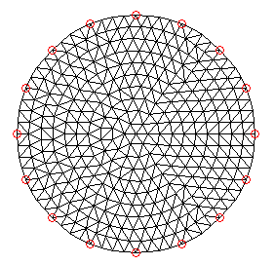
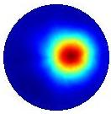
Electrical Impedance Tomography (EIT)
Data Acquisition
Image Reconstruction
Conductivity Map
σ_{N}
σ₂
σ₁
Hardware
apply current (or voltage) to a set of electrodes in contact with a region of interest and measured the resulting voltage (or current) from the same (or a different) set of electrodes
Computer Model
given that we can apply some current (or voltage) and measure the resulting voltage (or current) how can we compute an estimate of the internal electrical property distribution
Clinical Image
Notes:
Three primary components to system design: electrodes and probe geometery, hardware for current and voltage sensing, and software…
So to do that you can place a number of electrodes around some body of interest. In this case I am just showing some circular body part with some region of different conductivity embedded within it. The red lines represent electrodes place on the periphery of the object and you can measure the impedance between different pairs of electrodes. In this schematic as we measure between the top electrode along the sigma 1 path we measure one impedance while if we measure along some other paths sigma 2 we would measure some different impedance. We can measure the impedance between all the different pairings of electrodes. All of these data along with the geometery of the object and the eletcrode locations can be input to a computer model that performs some image reconstruction and we get out a map of the conductivity or other electrical properties. So you can really place these electrode in any configuration you want, but you have to have a pretty good idea of where you place them so you can construct a model that accurately matched the geometry of the imaging configuration.

Slide 9
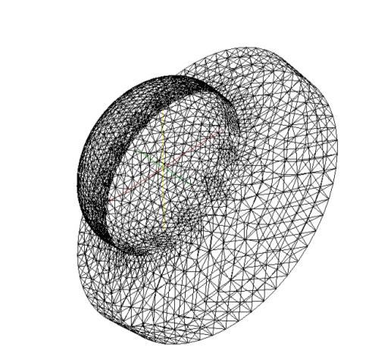
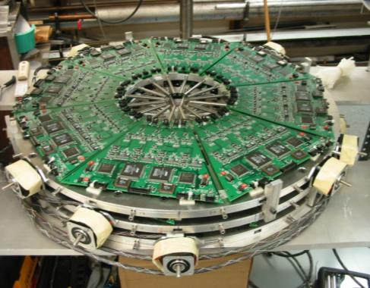
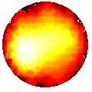
Breast EIT: 10x5x8 mm tumor lower outer quadrant
Data Acquisition
Image Reconstruction
Conductivity Map
Hardware
Computer Model
Clinical Image
Notes:
So here is an example of a breast imaging eit system that we have constructed. This was constructed as part of one of Keith Paulsens research programs in developing alternative modalities for breast imaging. We use a 3D mesh to represent the geometry of the breast and in this case that is shown we have a woman with a tumor in here lower outer quadrant of her right breast. I don’t want to spend to much time on this and instead talk about a device we have developed for imaging the electrical properties of prostate.

Slide 10
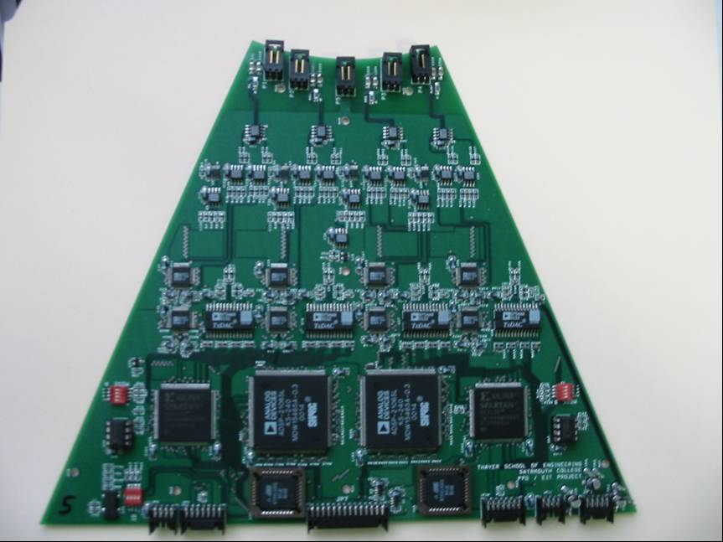
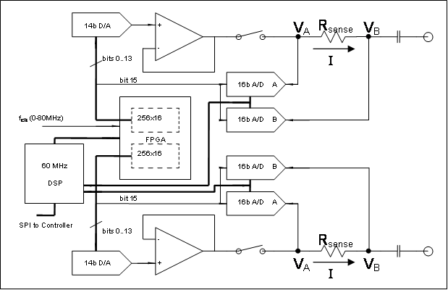
EIT Hardware Design
V_{C}
V_{D}
Z_{load}
C
D
D
C
V_{C}
V_{D}
Reconstruction Algorithm
Halter et al. IEEE TBME 2007
Notes:
Now I’ll just introduce a number of systems we have and are developing

Slide 11
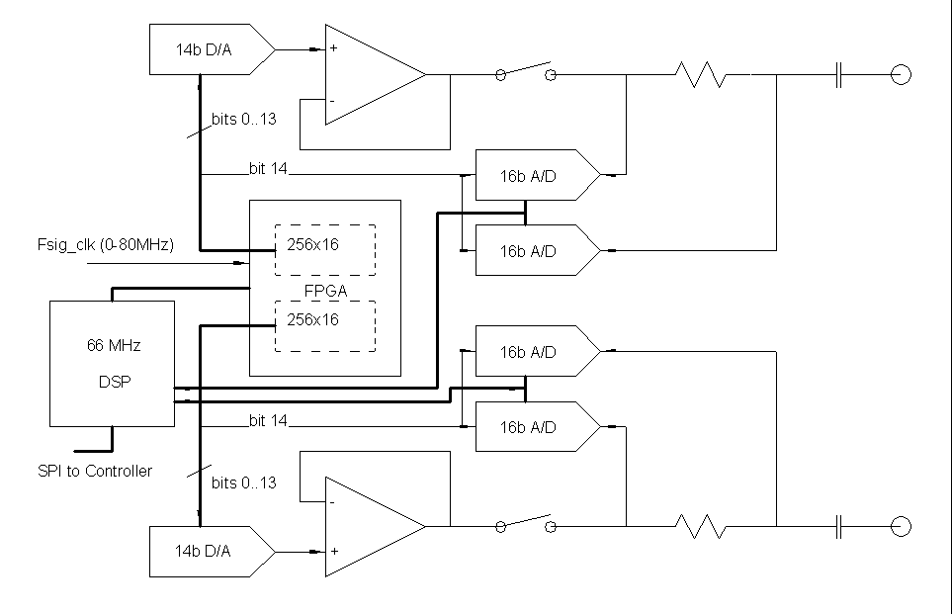
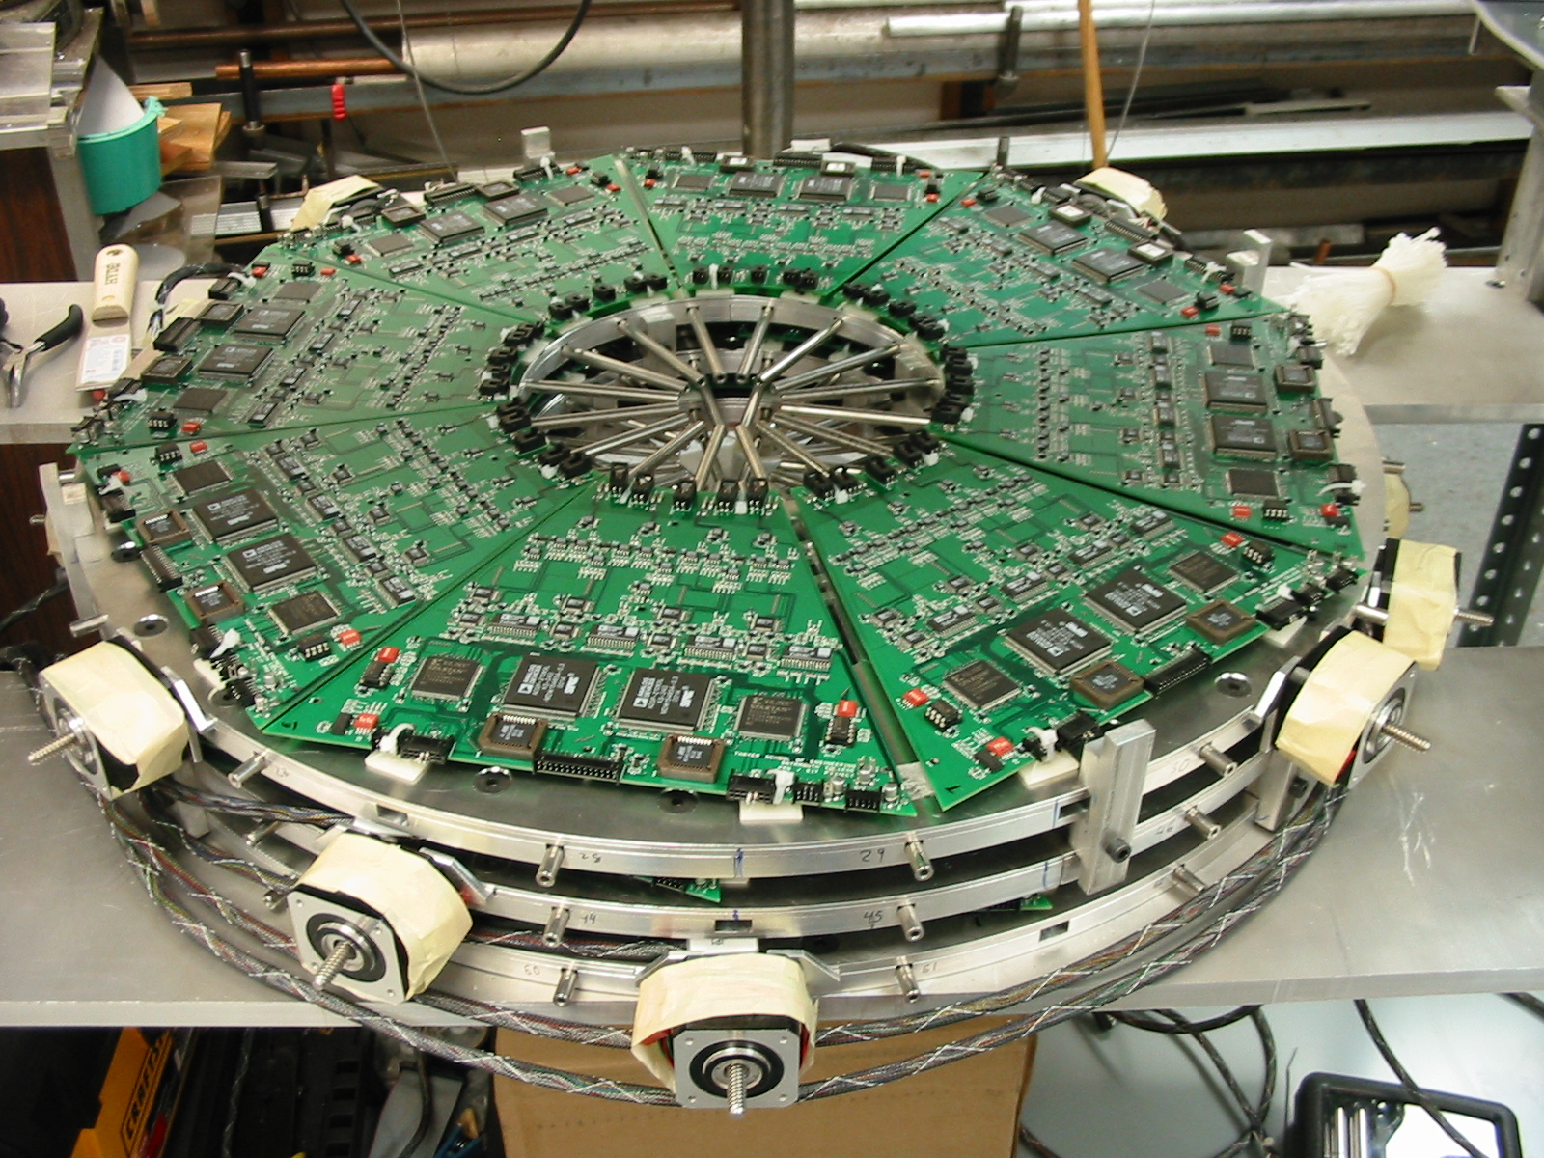
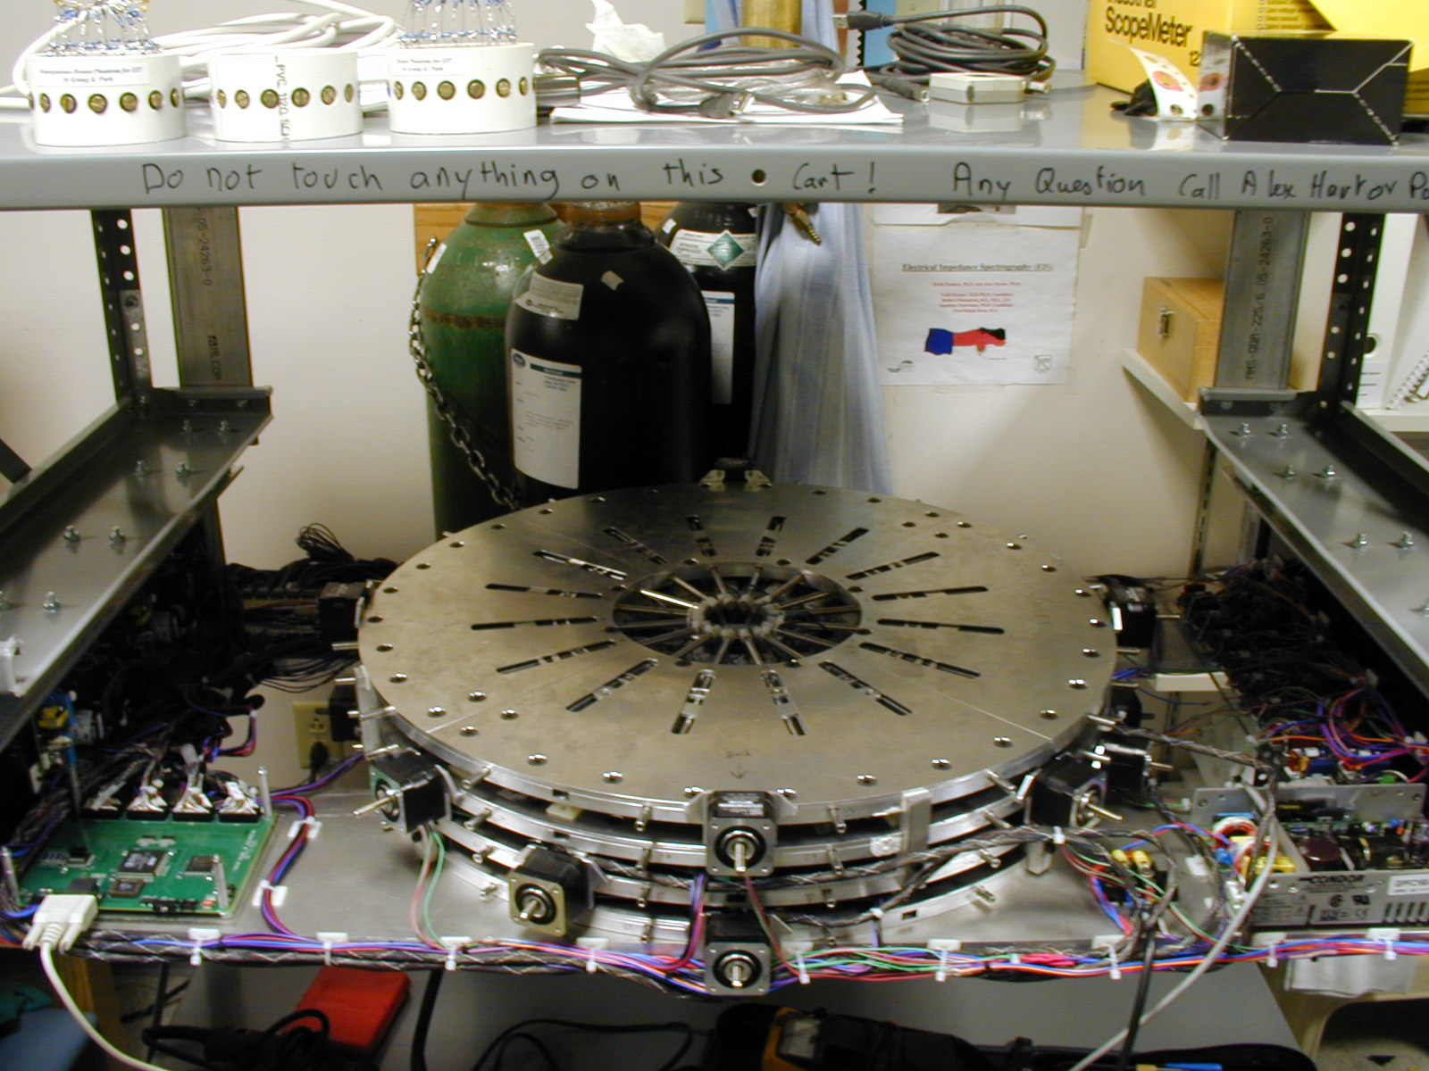
EIT Hardware Design
Channel A
Channel B
64 channels
10kHz - 10MHz
14bits signal gen
16bits acquisition
~97dB SNR
~3 fps continuous imaging
~30 frames/s in bursts
Halter et al. IEEE TBME 2007
Notes:
REFERENCE

Slide 12
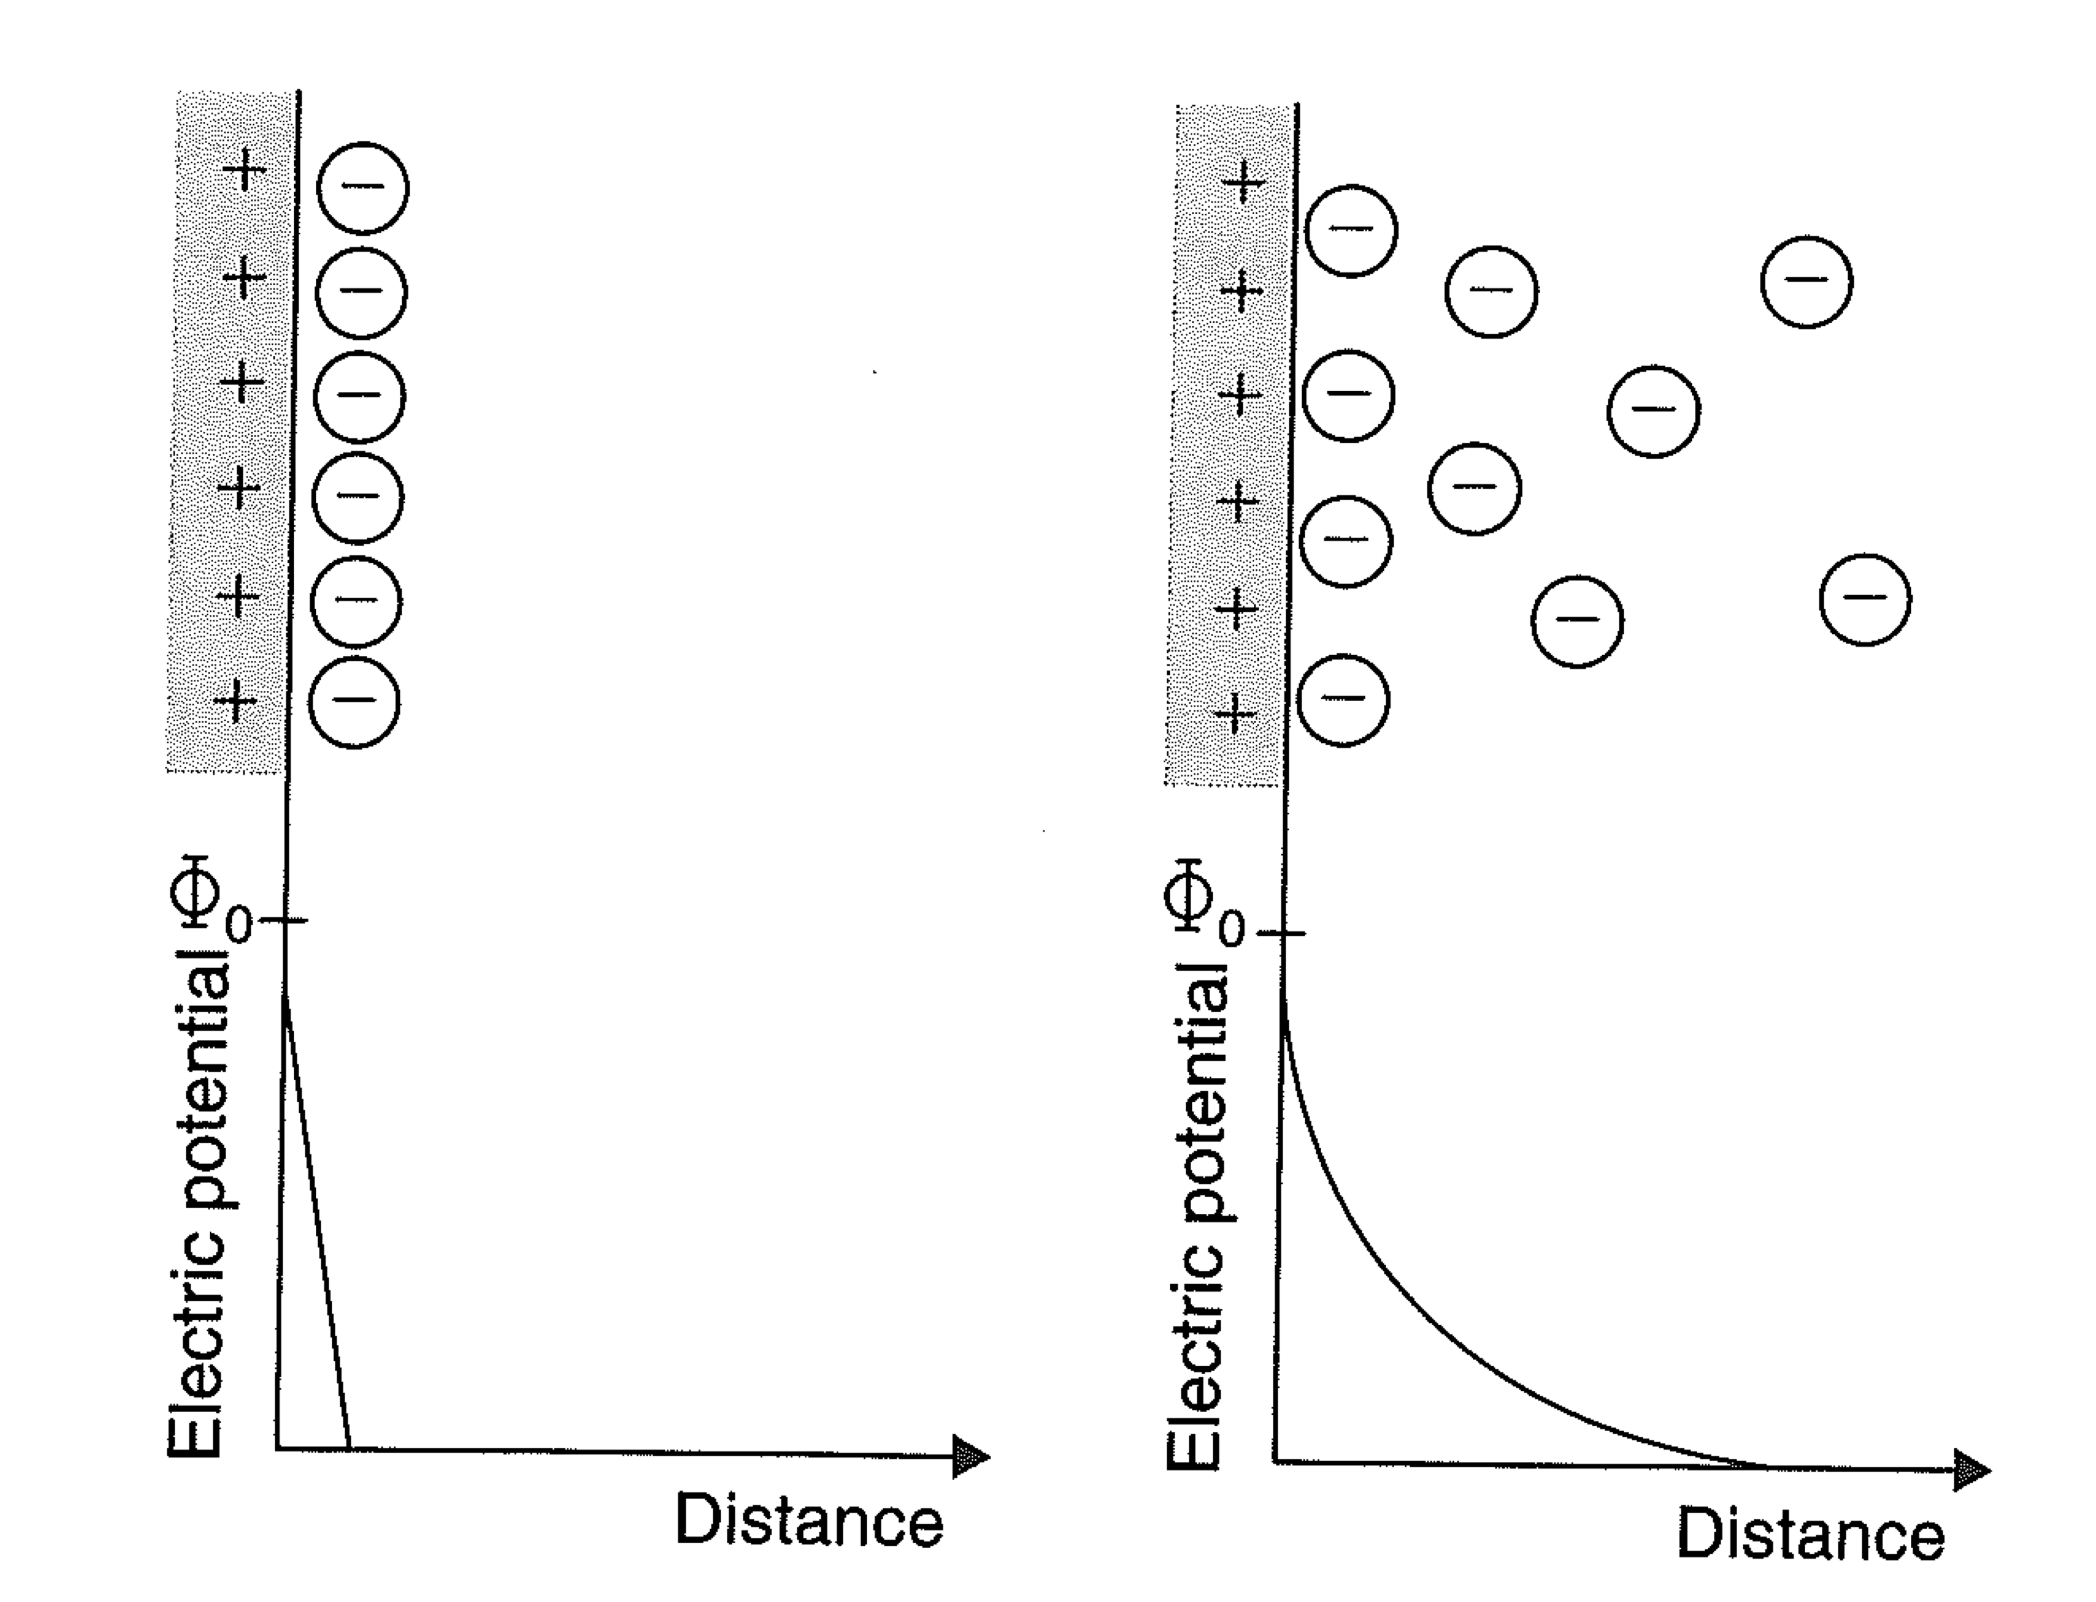
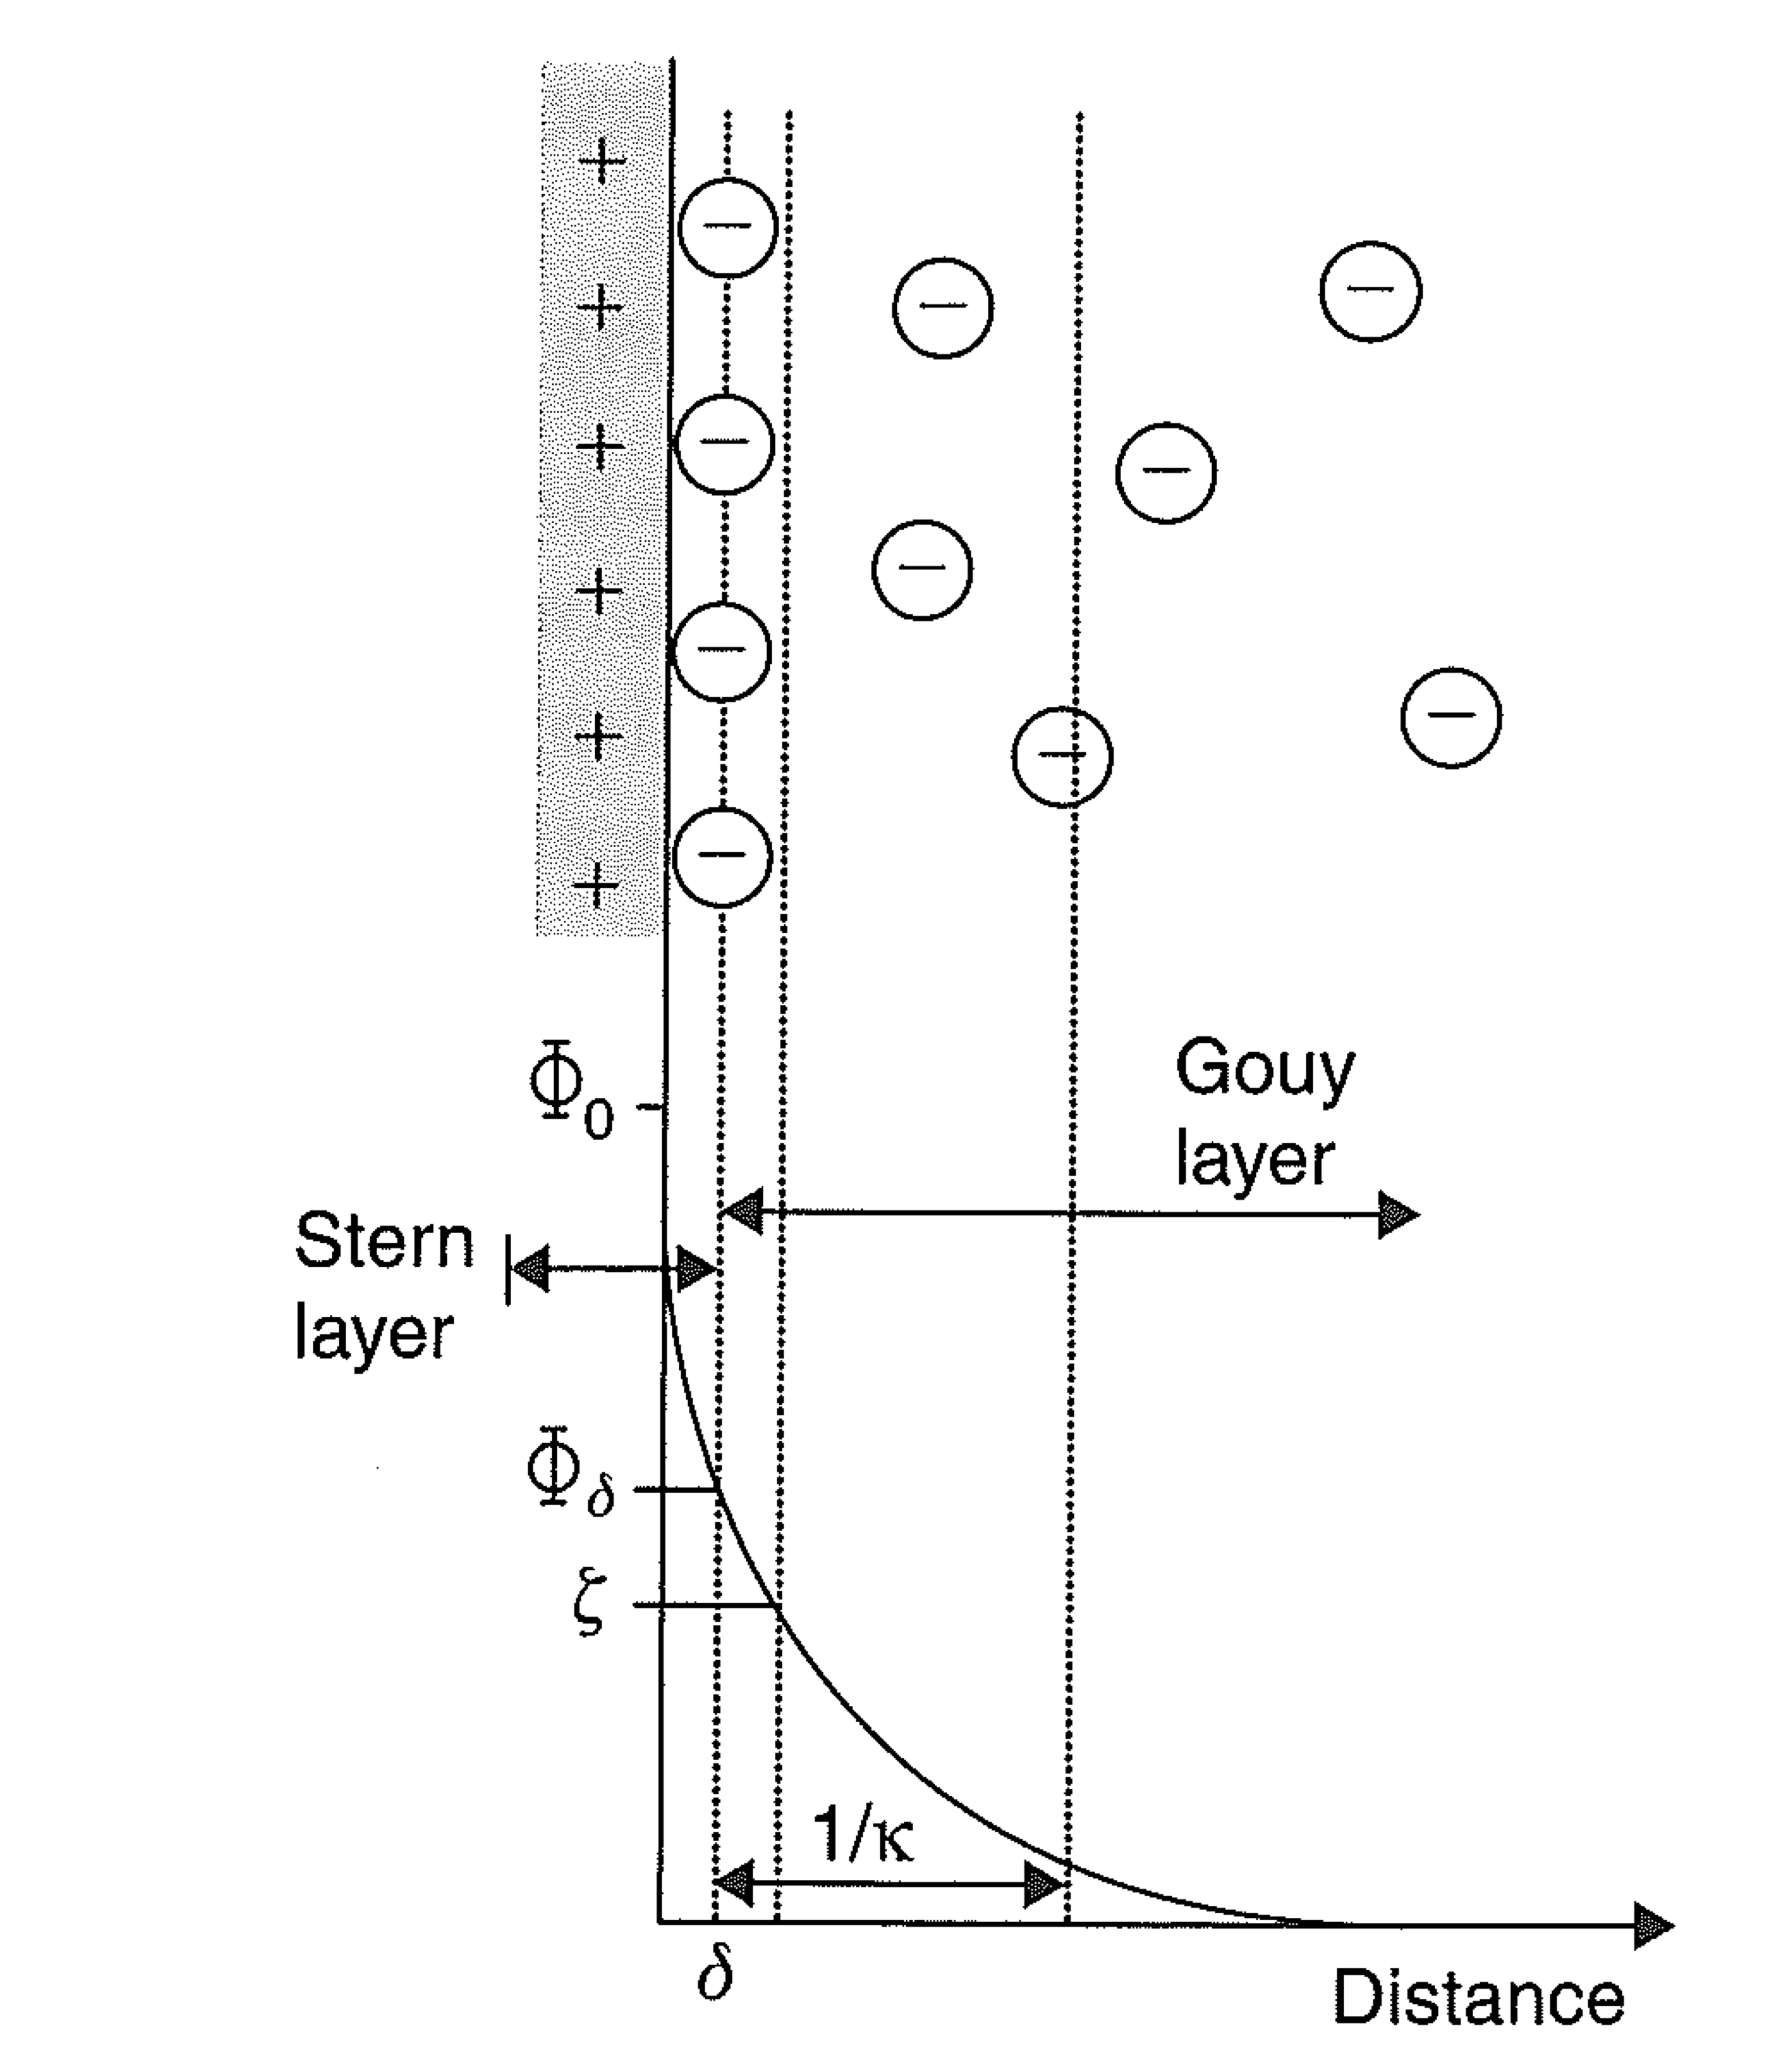
Electrode-Tissue Interface
Helmholtz
Gouy-Chapman
Stern

Slide 13
Bioimpedance-based Biometric

Slide 14
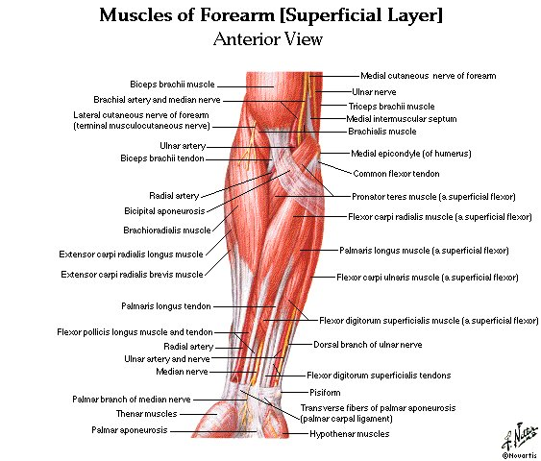

Slide 15
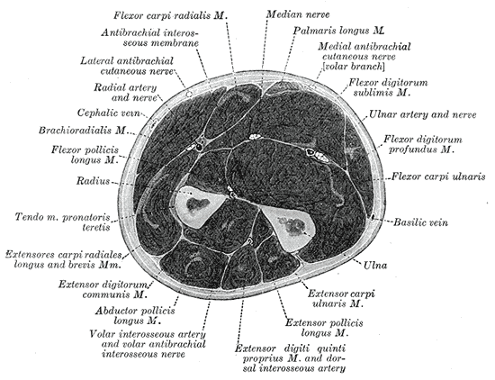

Slide 16
Bioimpedance-based Biometric
Feature extraction – max magnitude, spectral shape features (i.e. slope, intercept)
Test vector includes 7 features
Classification – k-Nearest Neighbors, Naïve Bayes, Logistic Regression, Linear Discriminant Analysis
Cornelius et al “Who wears me? Bioimpedance as a passive biometric”, submitted 2012

Slide 17
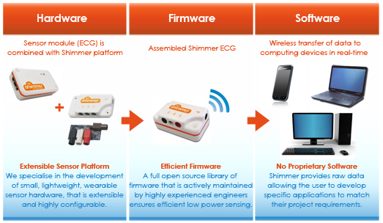
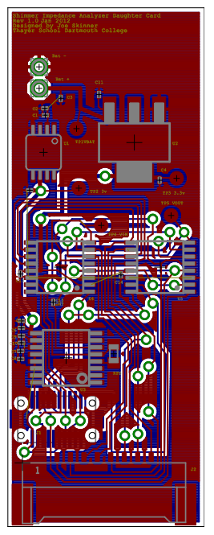
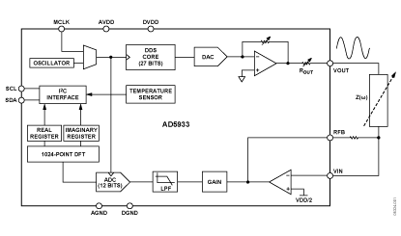
Wearable EIT
18.25 mm
Power Regulation
Custom 8-Channel
EIS Module
2 x 1-8 MUXs
48 mm
AD5933 – IC Z-Analyzer
AD5933
Shimmer interface
8-channel electrode interface

Slide 18
AD5933

Slide 19
AD5933
Package: 16-lead SSOP

Slide 20
AD5933

Slide 22
AD5933 Register Map

Slide 23
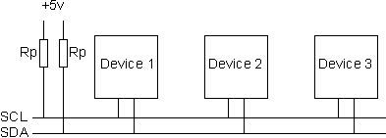
AD5933 I²C Protocol

Slide 24
AD5933 I²C Protocol

Slide 25
http://www.cypress.com/?docID=32287

